Slide 2


Have Your Pi and Eat It Too: .NET Core on Raspberry Pi
Cam Soper
Microsoft
@CamSoper CamSoper

Slide 3
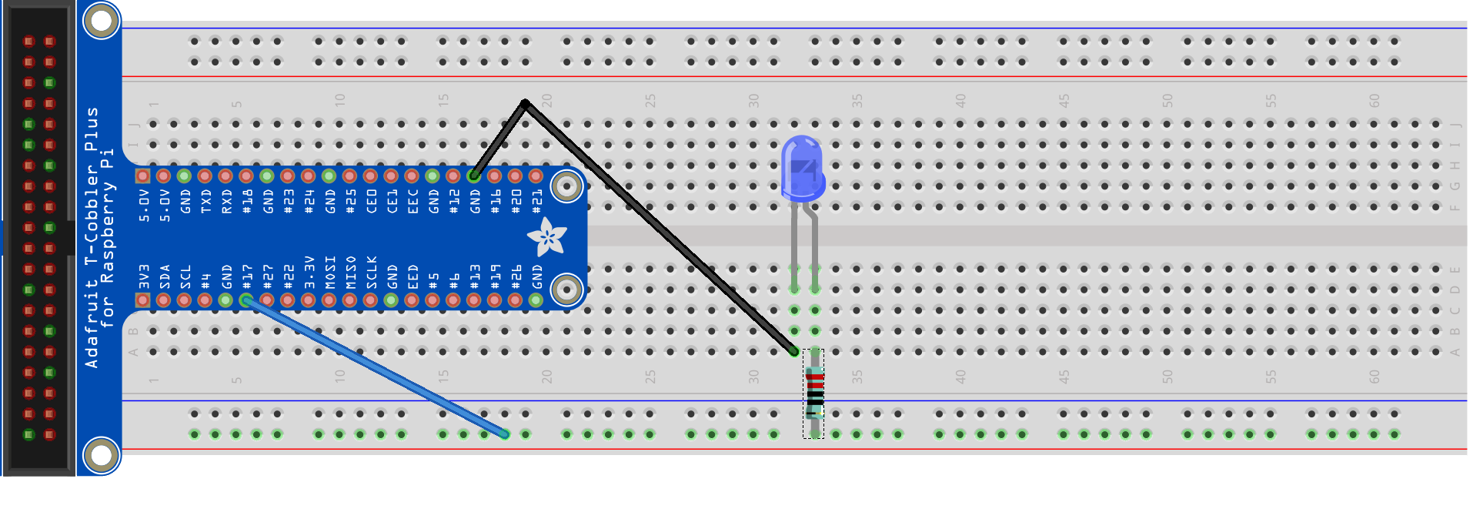
Hello World (LED)
Ground
GPIO 17

Slide 4
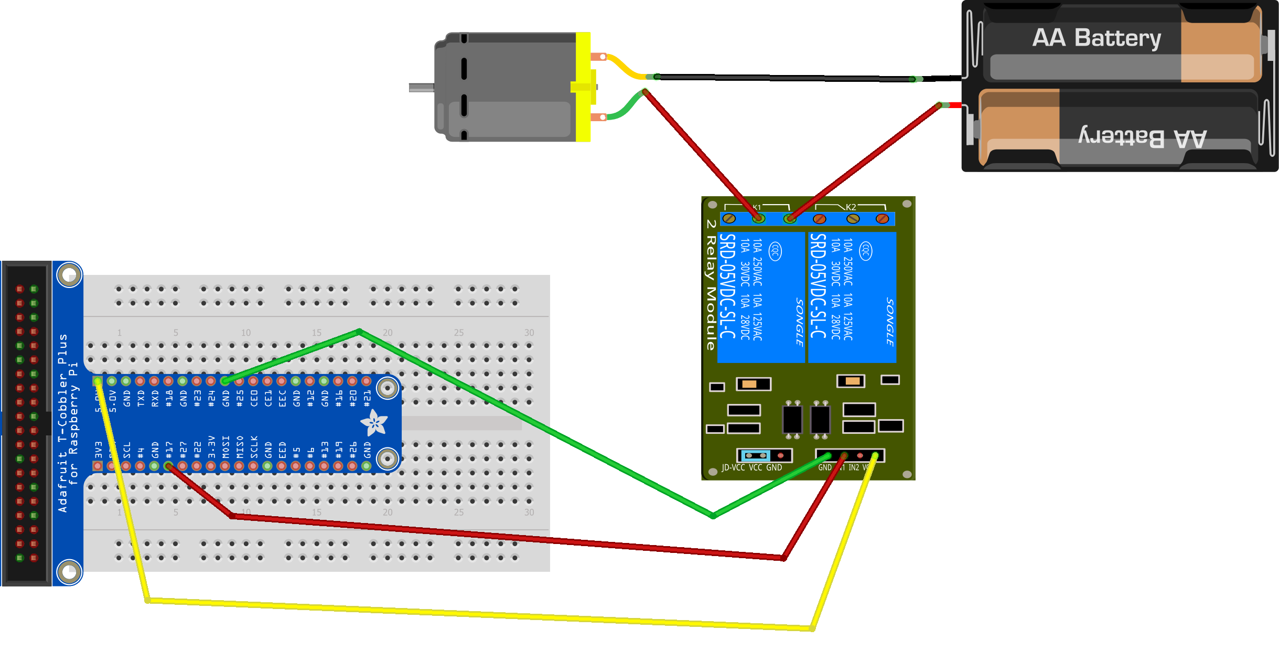
Hello World (Motor)
Ground
GPIO 17
5V

Slide 5
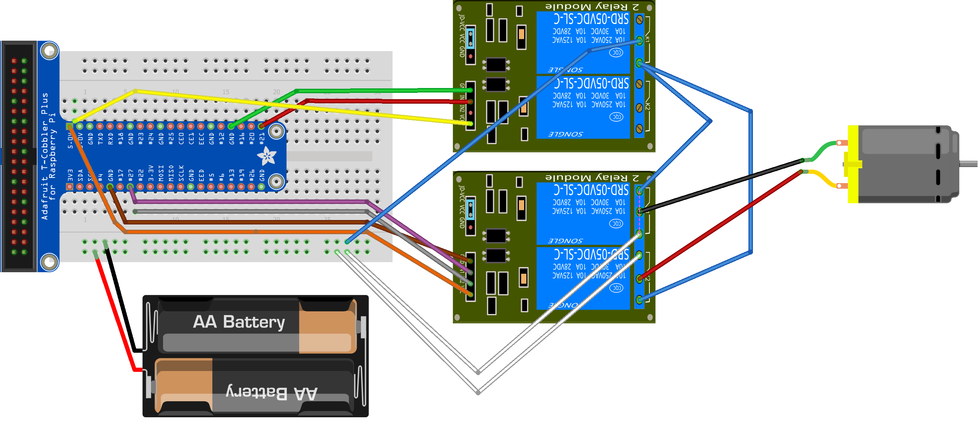













Reversible Motor

Slide 6
Push Button
GPIO 20
3.3 V

Slide 7
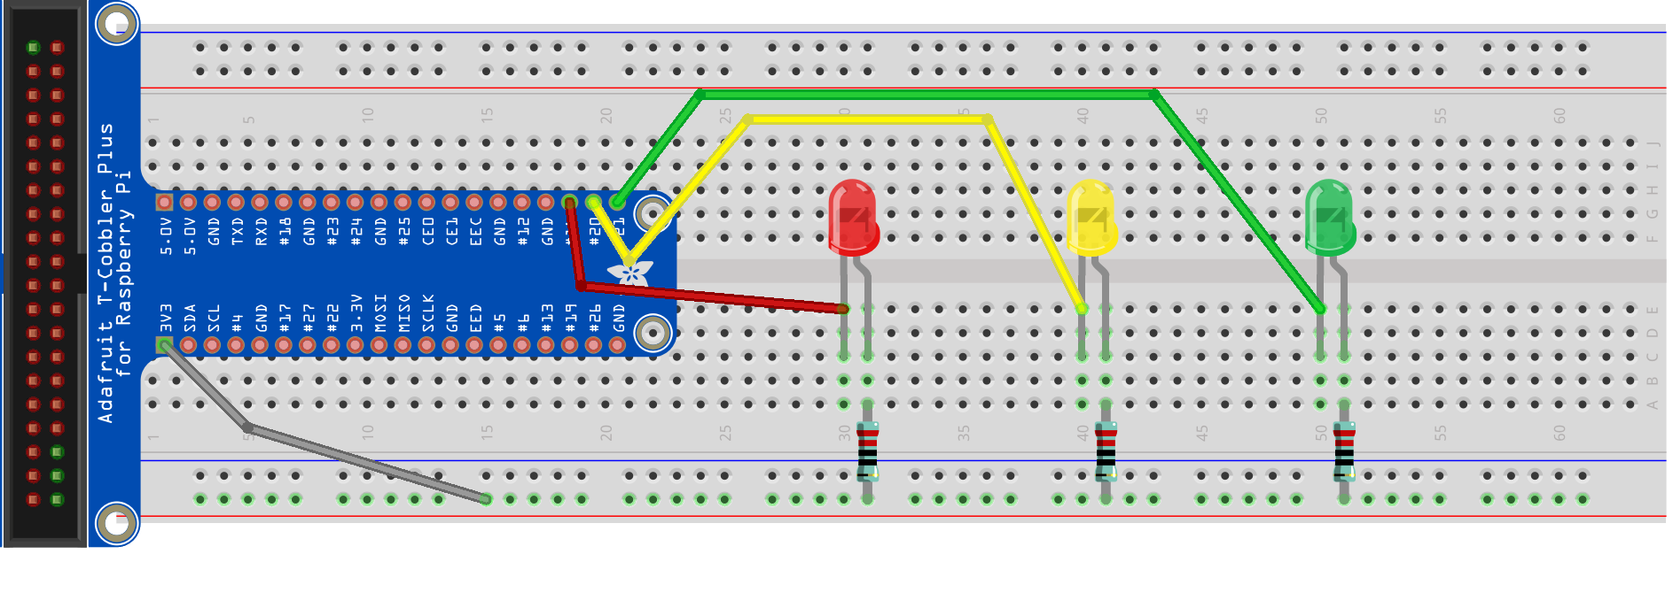
LED Array
GPIO 20
GPIO 21
GPIO 16
3.3 V

Slide 9
Demo intro slide

Slide 10
Hello World (LED)

